Slide 1
Logic
Entailment means that one thing follows logically from another.
If α and β are two sentences and α entails β i.e. β follows α (i.e. β follows from α), then it is symbolized as follows:
α |= β
α |= β iff in every model in which α is true, β is also true.
If α is true, then β must be true. But if α is true, but β is false, then entailment relation fails.
The truth of β is “contained” in the truth of α.

Slide 2
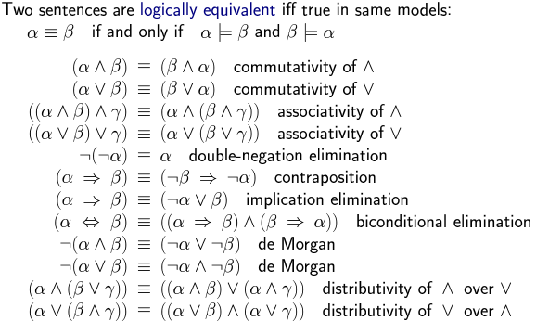
PROPOSITIONAL THEOREM PROVING (Logical Equivalence, Validity, Satisfiability)

Slide 3
PROPOSITIONAL THEOREM PROVING (Logical Equivalence, Validity, Satisfiability) …
A sentence is valid if it is true in all models
e.g. True, A ∨ ¬A, A ⇒ A, (A ∧ (A ⇒ B) ⇒ B
Validity is connected to inference via the Deduction Theorem
KB |= α iff (KB ⇒ α) is valid
Hence, we can decide if α |= β by checking that (α ⇒ β) is true in every model—which is essentially what the inference algorithm does or by proving that (α ⇒ β) is equivalent to True. Conversely, the deduction theorem states that every valid implication sentence describes a legitimate inference.

Slide 4
PROPOSITIONAL THEOREM PROVING (Logical Equivalence, Validity, Satisfiability) …
A sentence is satisfiable if it is True in, or satisfied by, some model.
For example, the knowledge base KB of Wumpus World given earlier, (R1 ∧ R2 ∧ R3 ∧ R4 ∧ R5), is satisfiable because there are three models in which it is true.
Many problems in computer science are really satisfiability problems. For example, all the constraint satisfaction problems ask whether the constraints are satisfiable by some assignment.
Validity and satisfiability are of course connected: α is valid iff ￢α is unsatisfiable; contrapositively, α is satisfiable iff ￢α is not valid.

Slide 5
PROPOSITIONAL THEOREM PROVING (Logical Equivalence, Validity, Satisfiability) …
We also have the following useful result:
α |= β if and only if the sentence (α ∧ ￢β) is unsatisfiable.
Proving β from α by checking the unsatisfiability of (α ∧ ￢β) corresponds exactly to the standard mathematical proof technique of reductio ad absurdum (literally, “reduction to an absurd thing”). It is also called proof by refutation or proof by contradiction.
One assumes a sentence β to be false and shows that this leads to a contradiction with known axioms α. This contradiction is exactly what is meant by saying that the sentence (α ∧ ￢β) is unsatisfiable.

Slide 6
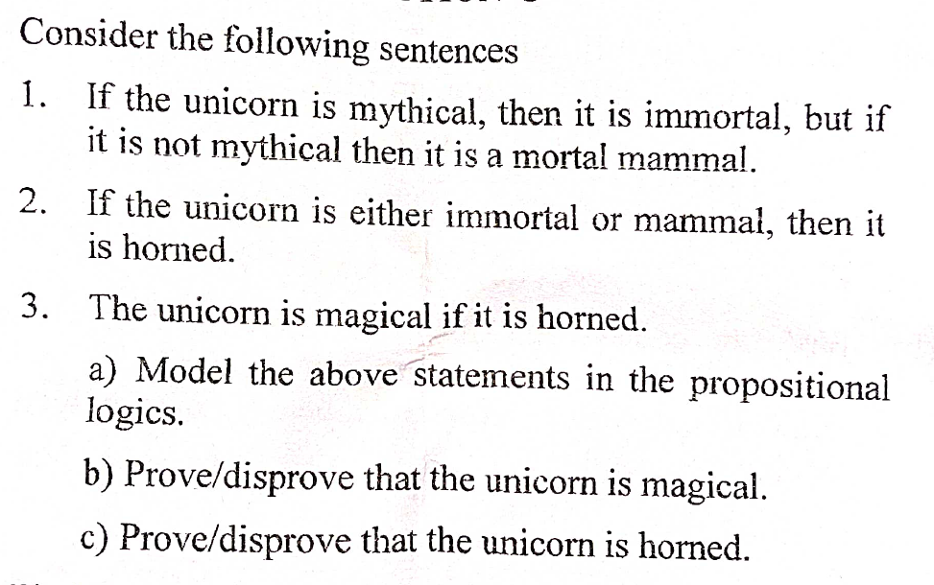

Slide 7
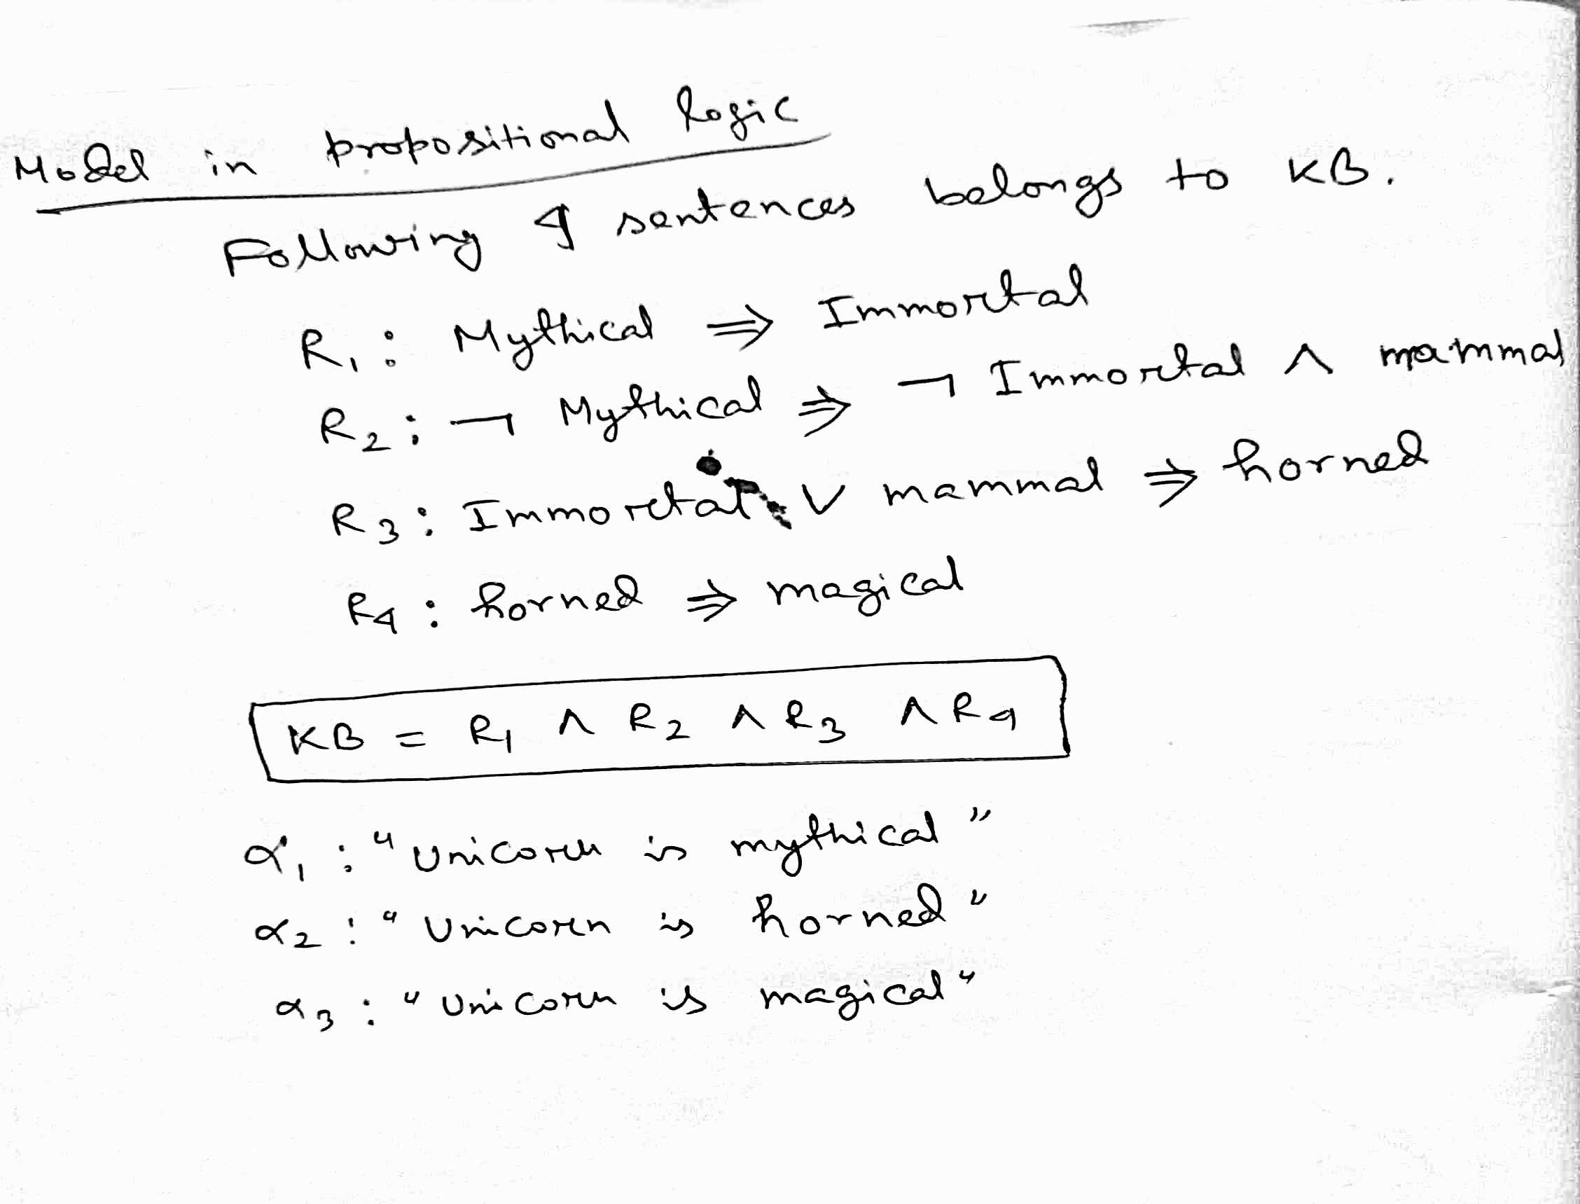

Slide 8
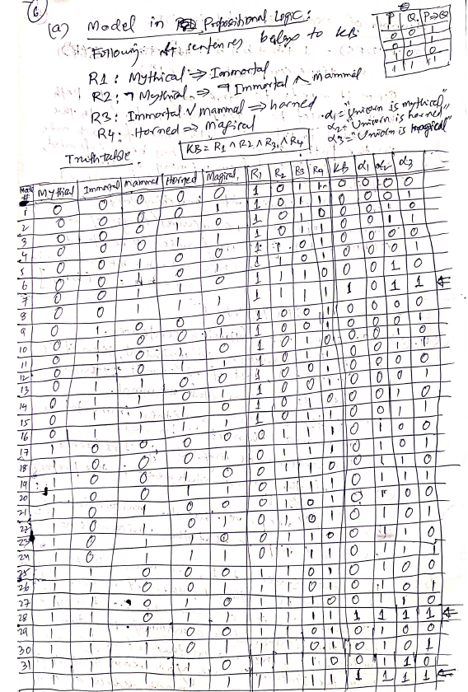

Slide 10
